Slide 1

BREEZE
ПГКПИ - 2021

Slide 2

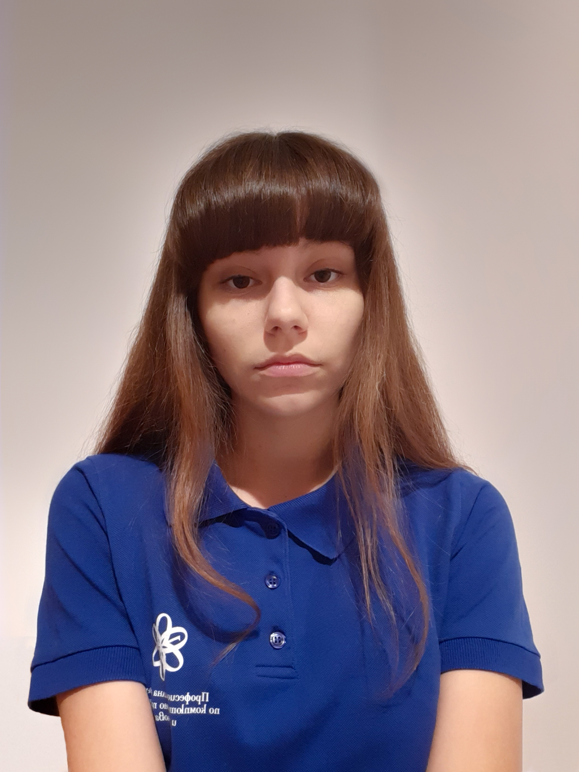

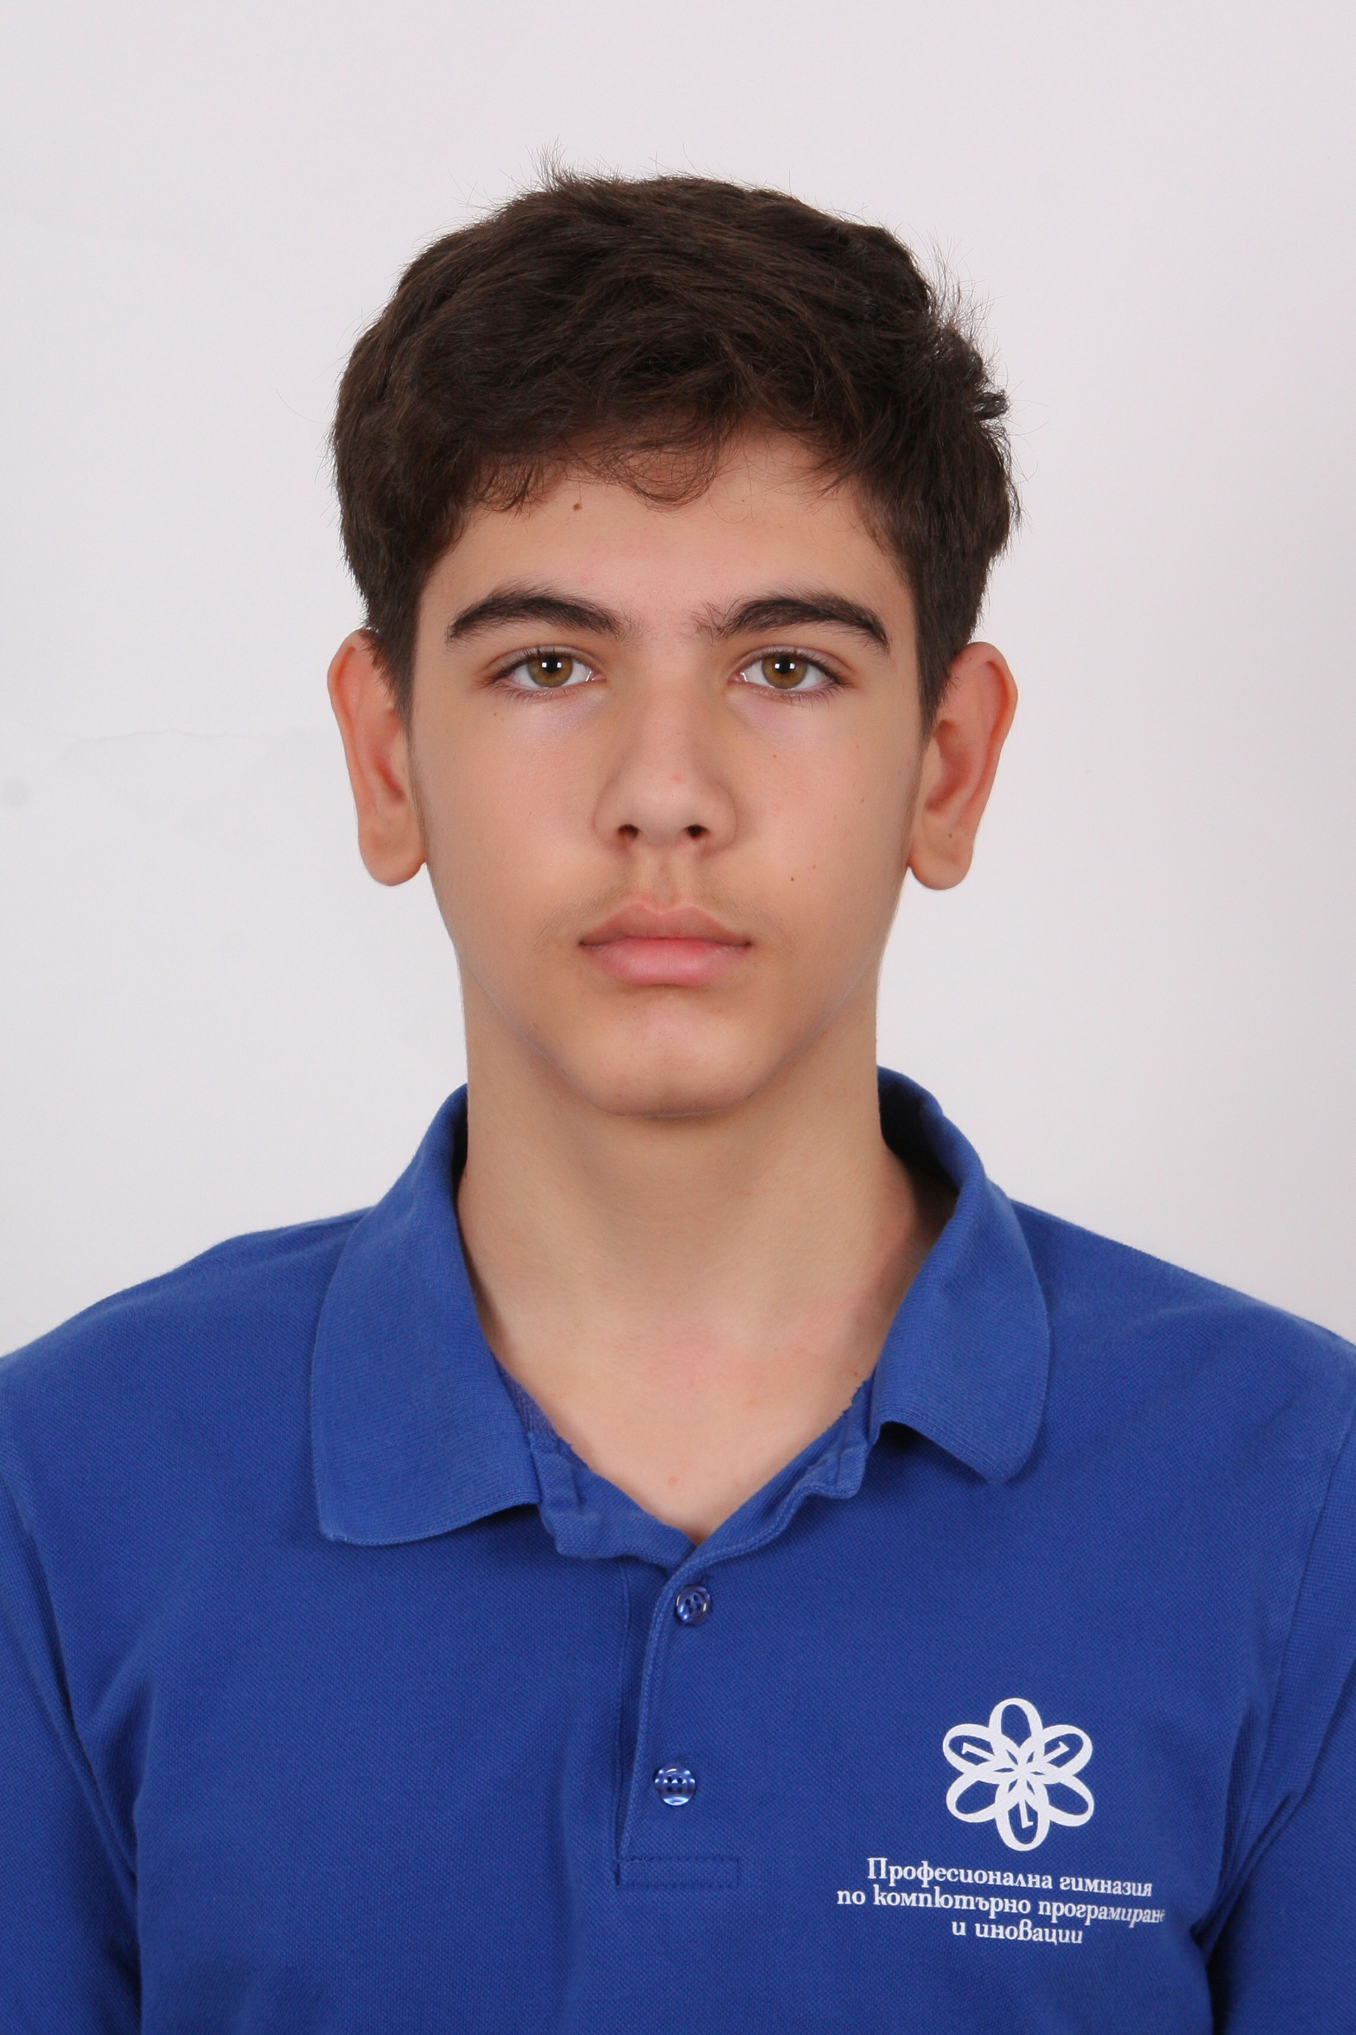
НАШИЯТ ОТБОР
M
M
M
И
Максимилиян Димов
Мария Илчева
Мирена Джебарова
Ивайло Радев
Scrum Trainer
Front-End Developer
Back-End Developer
Designer

Slide 3
ЕТАПИ НА РАБОТА
01
02
03
05
04
ИДЕЯ
ОРГАНИЗАЦИЯ
РЕАЛИЗАЦИЯ
ТЕСТВАНЕ
ПРЕЗЕНТИРНЕ

Slide 4




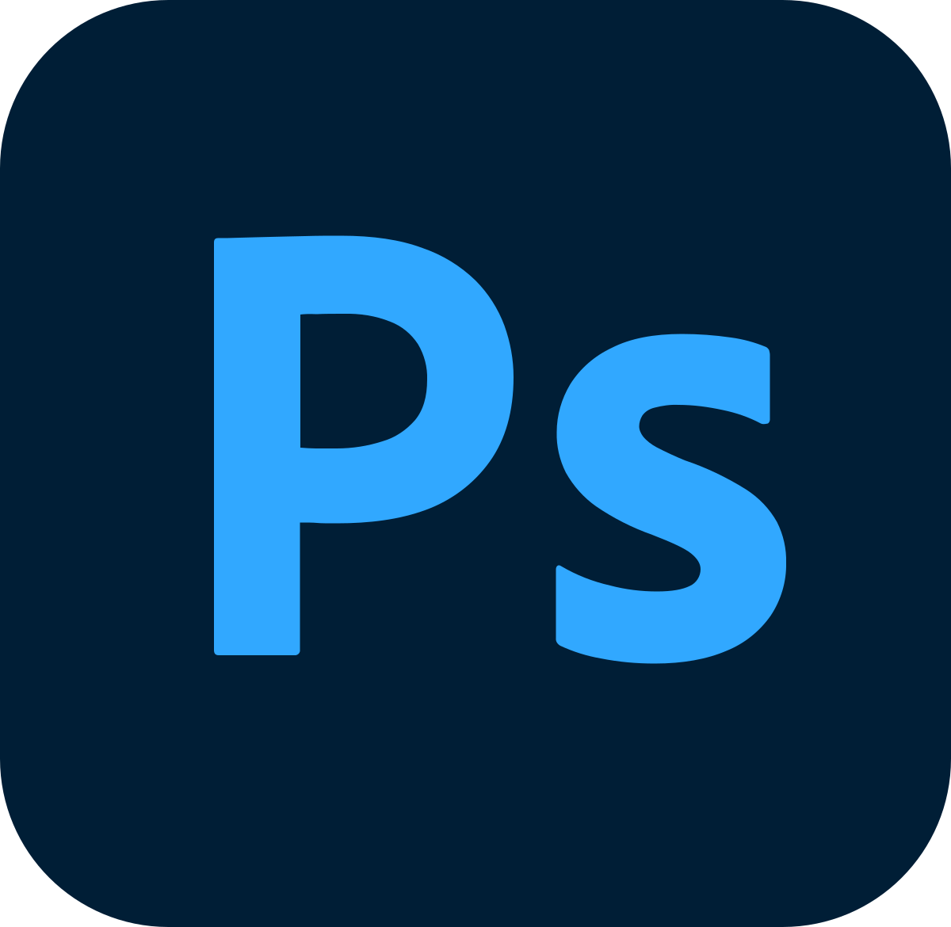



ИЗПОЛЗВАНИ ПРОГРАМНИ ЕЗИЦИ И ПРОГРАМИ

Slide 5




БЪДЕЩИ ИДЕИ

Slide 6

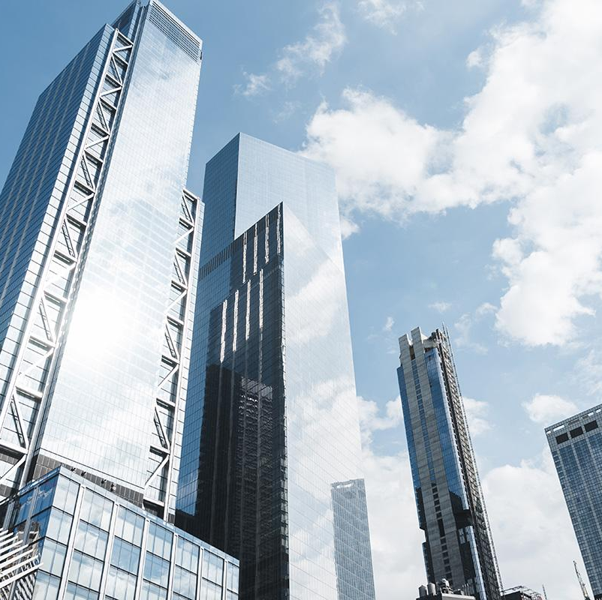

INTRODUCTION
Mercury is the closest planet to the Sun and the smallest one in the Solar System—it’s only a bit larger than the Moon. The planet’s name has nothing to do with the liquid metal, since it was named after the Roman messenger god, Mercury

Slide 7

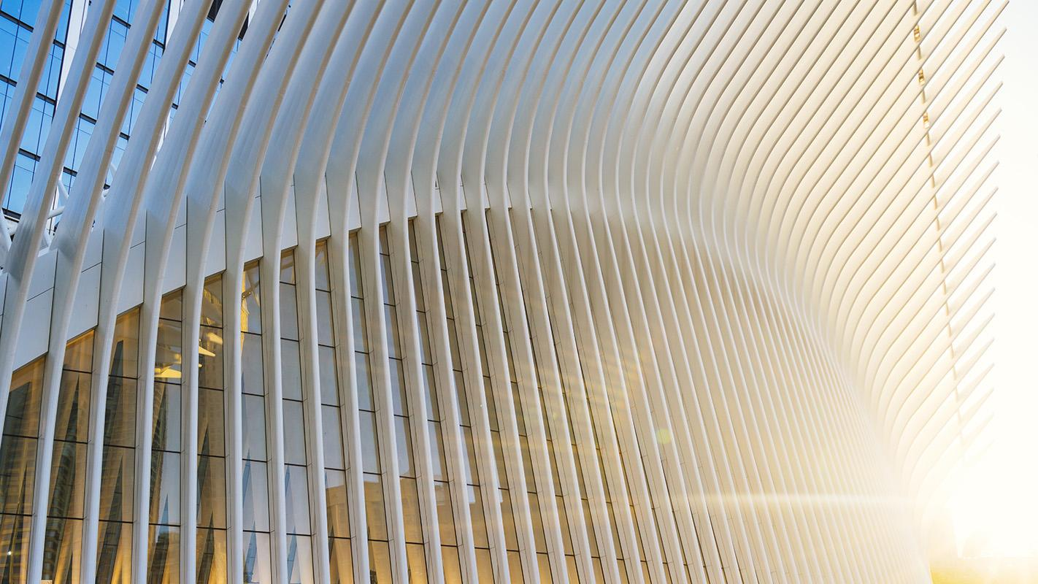
OUR COMPANY
Jupiter is a gas giant, the biggest planet in the Solar System and the fourth-brightest object in the night sky. It was named after the Roman god of the skies and lightning. This planet is composed mainly of hydrogen and helium

Slide 8

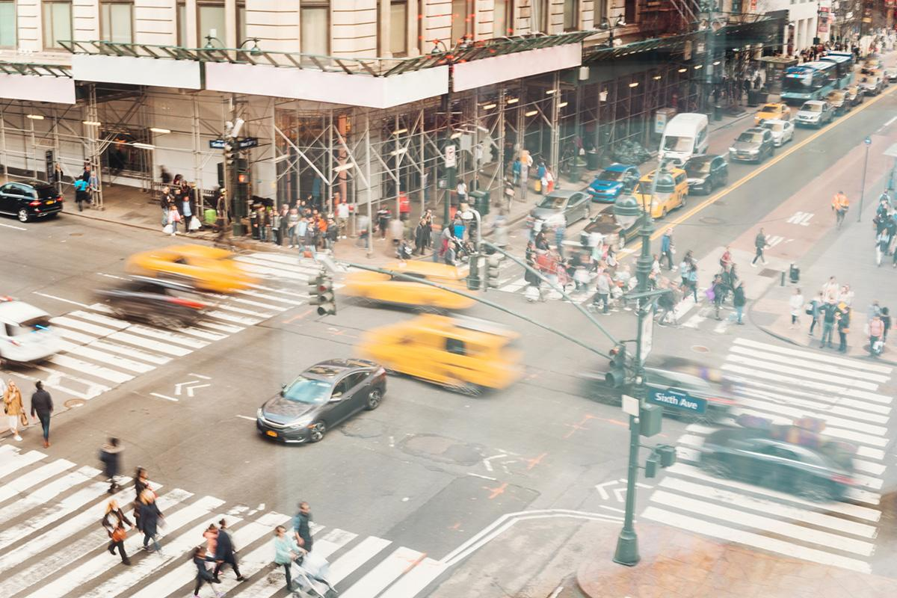

PROBLEM
Venus has a beautiful name and is the second planet from the Sun. It’s terribly hot—even hotter than Mercury—and its atmosphere is extremely poisonous. It’s the second-brightest natural object in the sky after the Moon

Slide 9
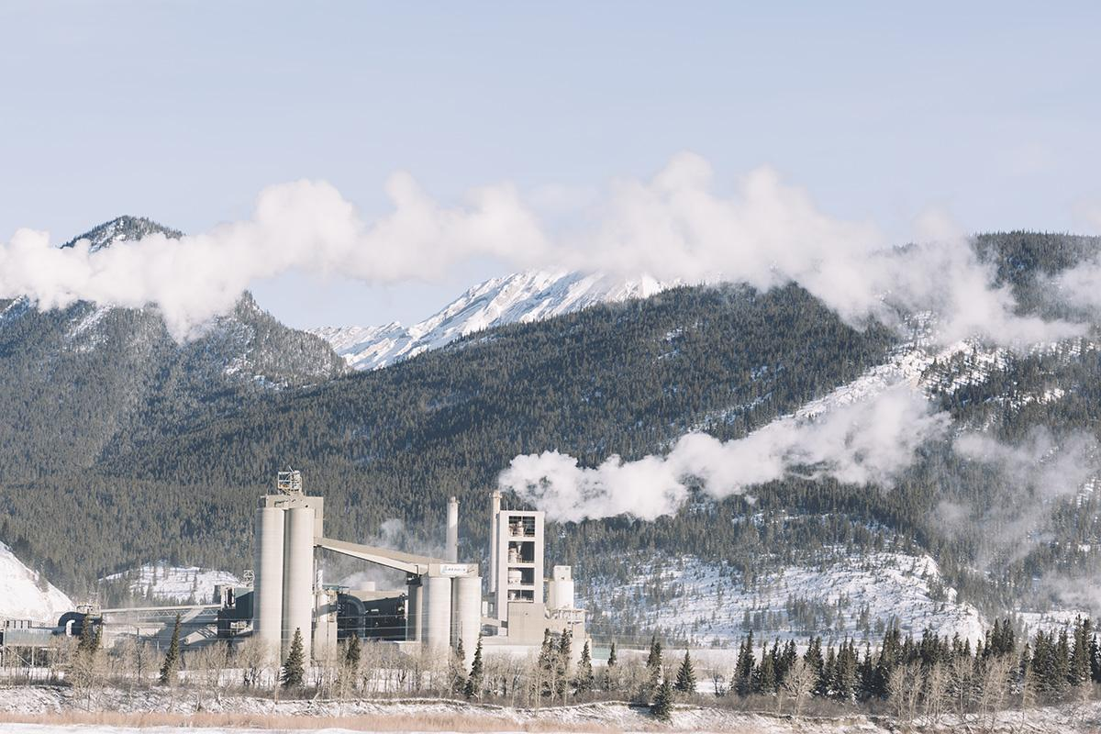
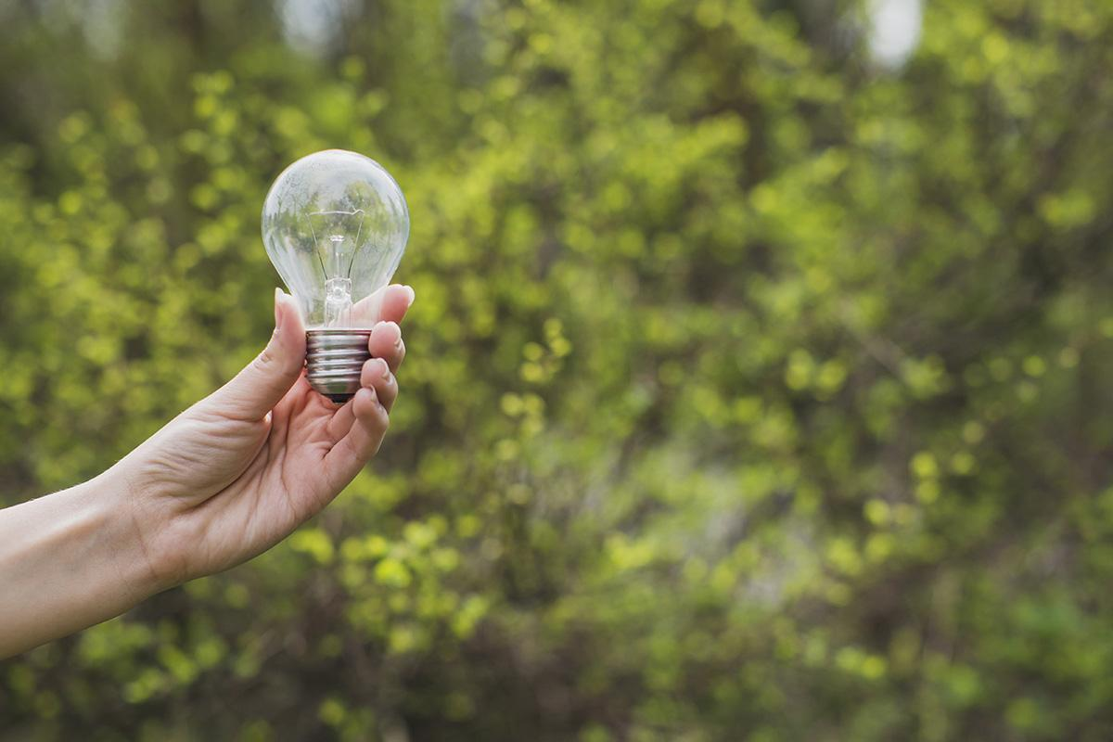
COMPETITIVE ADVANTAGE
THEM
US
Mercury is the closest planet to the Sun and the smallest one in the Solar System
Neptune is the fourth-largest planet in the Solar System and the farthest one from the Sun

Slide 10



SOLUTION
Mercury is the closest planet to the Sun and the smallest one in the Solar System—it’s only a bit larger than the Moon. The planet’s name has nothing to do with the liquid metal, since it was named after the Roman messenger god, Mercury

Slide 11
—SOMEONE FAMOUS
“This is a quote. Words full of wisdom that someone important said and can make the reader get inspired.”

Slide 12
AWESOME WORDS

Slide 13
SWOT ANALYSIS
Venus has a beautiful name, but its atmosphere is extremely poisonous
Saturn is the ringed one. It’s a gas giant, composed mostly of hydrogen and helium
S
W
Neptune is the farthest planet from the Sun and the fourth-largest in the Solar System
0
T
Mercury is the closest planet to the Sun and the smallest one in the Solar System

Slide 14
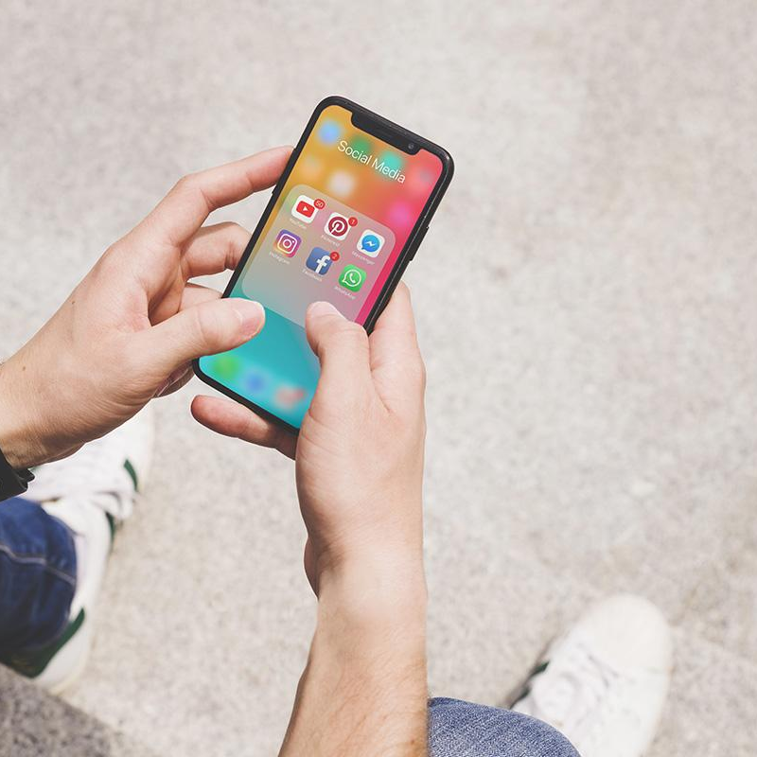
PRODUCT OVERVIEW
VENUS
1
MERCURY
2
MARS
3
Venus has a beautiful name and is the second planet from the Sun
Mercury is the closest planet to the Sun and the smallest one
Neptune is the eighth and farthest planet from the Sun

Slide 15
OUR PLANS
BASIC
PRO
PREMIUM
List your features
List your features
List your features
List your features
List your features
List your features
List your features
List your features
List your features
$30
$50
$70

Slide 16
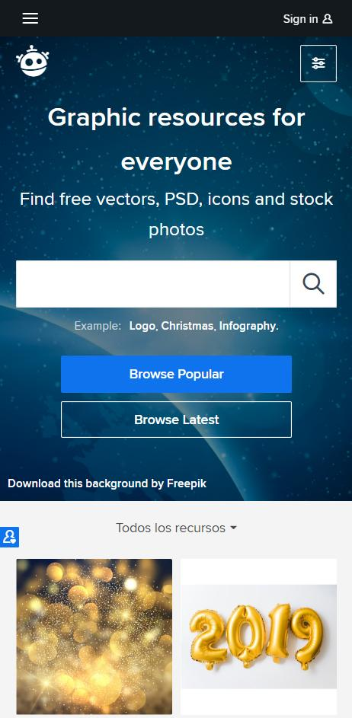

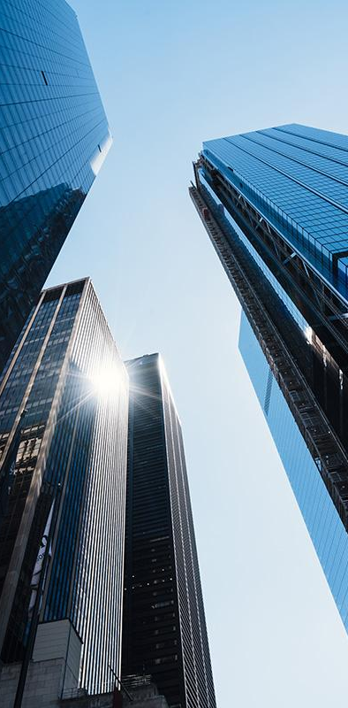
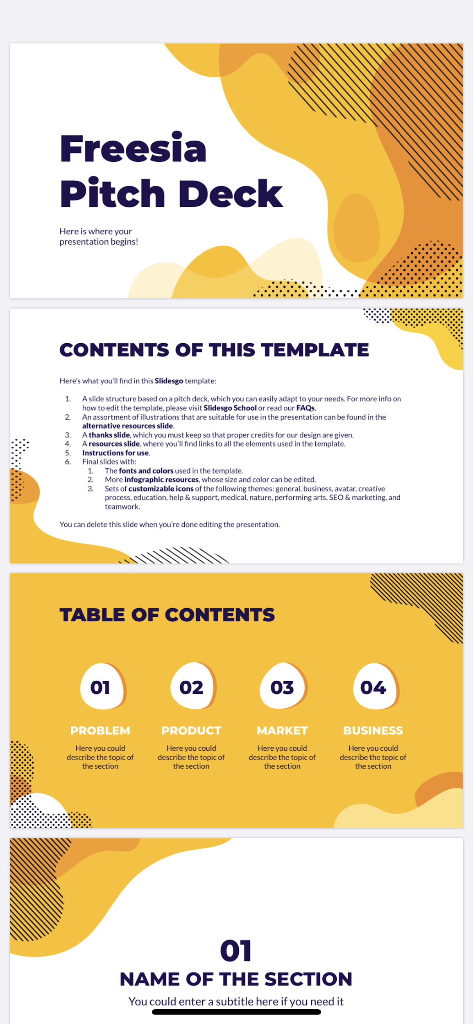
PRODUCT DEMO
INTERFACE
You can replace the images on these screens with your own work. Just delete these ones, add yours and send them to the back

Slide 17
CLOSE VIEW
UI/UX VIEW
Venus has a beautiful name and is the second planet from the Sun. It’s terribly hot—even hotter than Mercury—and its atmosphere is extremely poisonous
NEPTUNE
Neptune is the eighth planet.

Slide 18
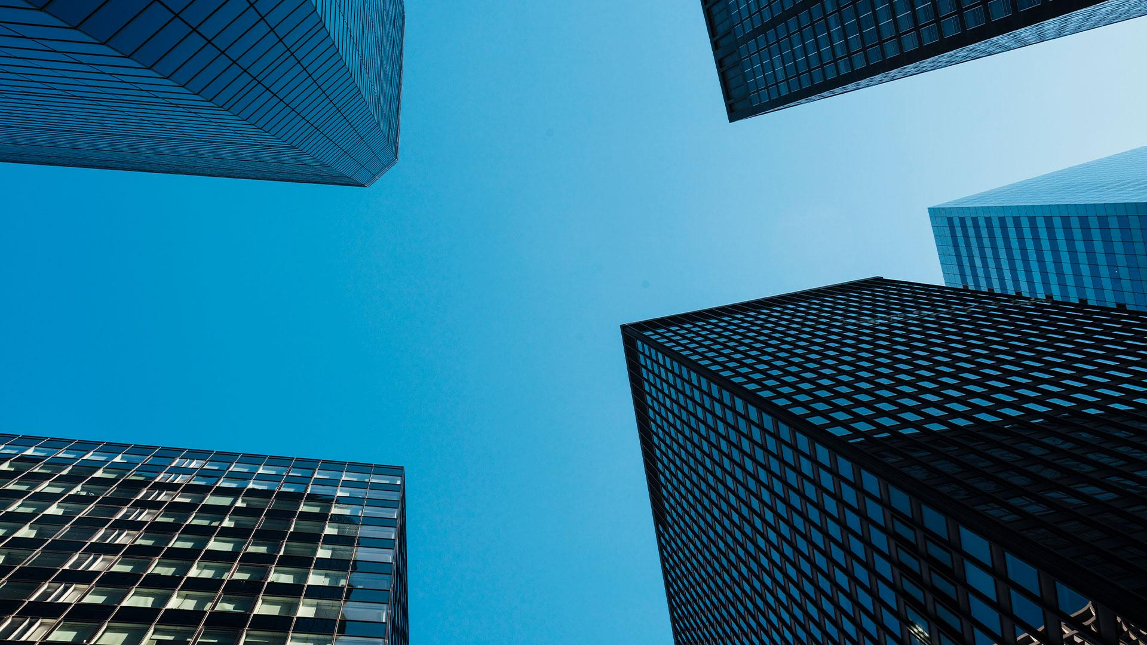
A Picture Is Worth a Thousand Words

Slide 19
INVESTMENT
JUPITER
10%
It’s a gas giant and the biggest planet in the Solar System
SATURN
30%
Saturn is a gas giant, composed mostly of hydrogen and helium
MERCURY
60%
This planet is the smallest one in the Solar System

Slide 20
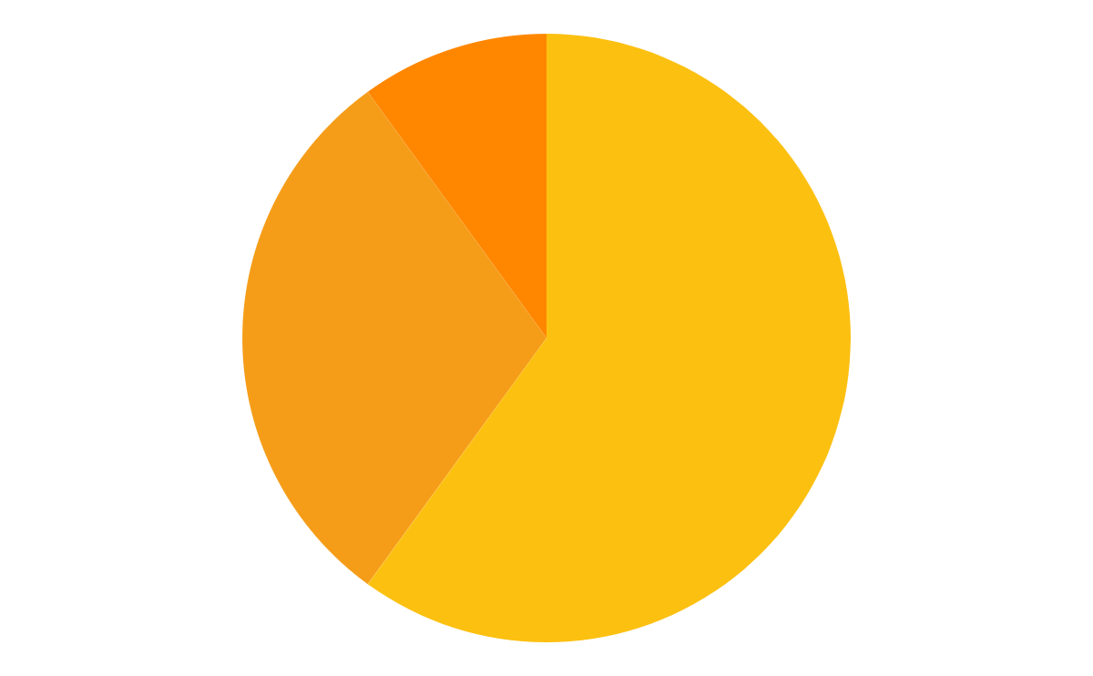
TRACTION
40,000
50,000
60,000
30%
Despite being red, Mars is actually a cold place full of iron oxide dust
60%
Jupiter is a gas giant and the biggest planet in the Solar System
10%
Venus has a beautiful name and is the second planet from the Sun
To modify this graph, click on it, follow the link, change the data and replace it here

Slide 21
CASE STUDY
1
2
3
4
CHALLENGE
BUDGET
RESULTS
SOLUTIONS
Despite being red, Mars is actually a cold place full of iron oxide dust
Jupiter is a gas giant and the biggest planet in the Solar System
Venus has a beautiful name and is the second planet from the Sun
Saturn is a gas giant, composed mostly of hydrogen and helium

Slide 22


REVIEWS
“Jupiter is the biggest planet in the Solar System and the fourth-brightest object in the sky”
—ZAHRA WATKINS
“Mercury is the closest planet to the Sun and the smallest one in the Solar System”
—LOUIE STONE

Slide 23
AWARDS
MERCURY
VENUS
Mercury is the closest planet to the Sun and the smallest one in the Solar System—it’s only a bit larger than the Moon
Venus has a beautiful name and is the second planet from the Sun. It’s terribly hot, even hotter than Mercury

Slide 24
321,000,000
Big numbers catch your audience’s attention

Slide 25
MARKET SIZE
50%
40%
Venus is the second planet from the Sun
Mercury is the closest planet to the Sun

Slide 26
TARGET
Female
Male
1
SATURN
2
VENUS
3
MARS
90%
40%
20%
20%
80%
80%
55%

Slide 27
COMPETITORS
 | A | B | C | D
MARS
JUPITER
SATURN

Slide 28
BUSINESS MODEL
1.
2.
3.
VENUS
SATURN
MERCURY
Venus has a beautiful name and is the second planet from the Sun. It’s terribly hot
This is the ringed one. It’s a gas giant, composed of hydrogen and helium
Mercury is the closest planet to the Sun and the smallest in the Solar System
4.
5.
6.
NEPTUNE
JUPITER
MARS
Neptune is the fourth-largest planet in the Solar System
Jupiter is a gas giant and also the biggest planet in the Solar System
Despite being red, Mars is actually a cold place full of iron oxide dust

Slide 29
TIMING
Neptune is the farthest planet from the Sun
Jupiter is the biggest planet in the Solar System
Saturn is composed of hydrogen and helium
1
3
5
2
4
2
Venus has a beautiful name, but it’s terribly hot
Despite being red, Mars is actually a cold place

Slide 30
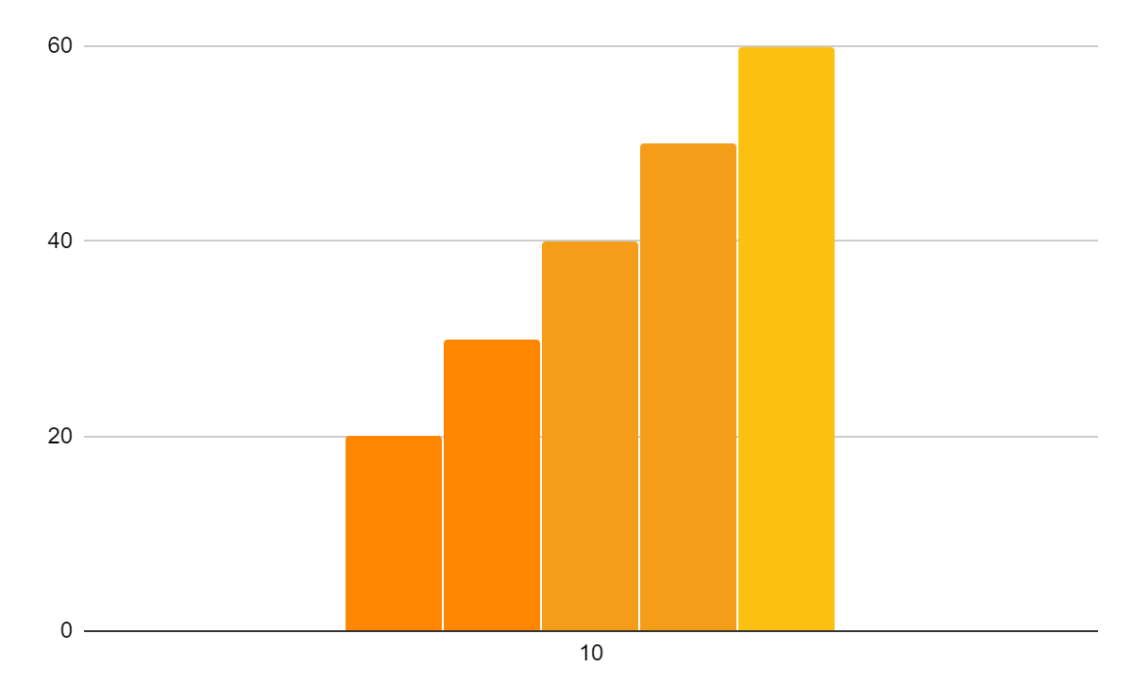
EXPECTED GROWTH
50%
$5M
Increased income
Expected income
20%
3,000
More employees
Total employees

Slide 31
THANKS!
Do you have any questions?
youremail@freepik.com
+91 620 421 838
yourcompany.com
Please keep this slide for attribution.

Slide 32
ALTERNATIVE RESOURCES

Slide 33
RESOURCES
VECTORS
Gradient abstract shape infographic
Retro colored infographic template
Abstract shape gradient infographic
Infographic elements pack
Gradient abstract shape infographic
Infographic with retro colors design
Flat infographic elements collection
Gradient abstract shape infographic
Gradient abstract shape infographic
Realistic iphone with wallpaper
Abstract organic shapes banners
Abstract fluid banner template

Slide 34
RESOURCES
PHOTOS
Overhead view of man's hand using social media app
Factory in high mountains
Hand holding light bulbs
Portrait of modern man
Lifestyle of young friends outdoors
Skyscrapers and clear blue sky
Hand holding a instant photo frame
Group of happy friend sharing images
Office mirrored tall buildings
Motion blur bridge with cars at night
Busy junction full of cars and people
Low angle buildings on sunny day
Glass building at sunrise
Close-up of businesswoman touching chart
Handsome young man on white background
Smiling woman

